Slide 1
Software Project Management
Controlling Process Group
(Managing Changes)

Slide 2
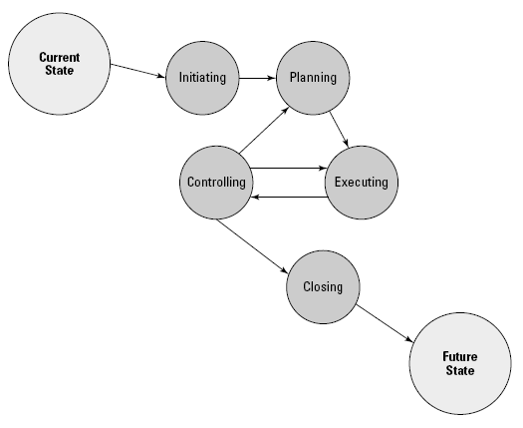
Process Groups

Slide 3
Controlling Process Group
According to the Project Management Institute, the project management process group that deals with managing change is the controlling process group.
Changes are inevitable and even necessary at times
The controlling process group is used to measure and compare where you are with where you planned to be.

Slide 4
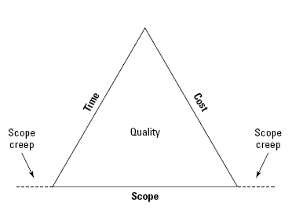
Controlling Project Scope
You need to remain constantly aware of all the details surrounding the scope of the project.
Be aware of the potential for scope creep

Slide 5
Scope Creep
Phenomenon in which some stakeholders lose perspective and begin to make requests that were never part of the original plan.
You can recognize scope creep when you begin hearing people express expectations that certain functionality - that you never planned for - ought to be included.

Slide 6
Controlling Project Scope
The project scope includes all of the work and only the work that needs to successfully complete the project.
You have several opportunities to examine your scope as you progressively elaborate the project scope.
Every time the scope changes, you must document the change - as well as its potential impact on costs and timelines - and then make sure the client signs off.

Slide 7
Change Control System
The purpose of the change control system is to identify, monitor, and learn from the changes occurring in your project.
Your change control system may consist of tools, such as a database or spreadsheet to record your proposed changes
Define your change control system early in the project. You don’t want to be confronted with proposed changes without having the appropriate processes in place to deal with them.
This documentation could also be used for a root cause analysis if you encounter system problems after changes are implemented

Slide 8
Change Control Board (CCB)
In addition to database or spreadsheet to record your proposed changes, you may also have a change control board (CCB) to review and approve changes in your firm
The CCB might have just two members or it could be a large committee
CCB is aware of all project changes and could determine whether your change may affect other portions of the software project

Slide 9
Value of the Proposed Change
When project changes are proposed, you need to determine
the cost of implementing the change, as well as
the value that the proposed change will add to the project.
For Example: It will cost $500 to implement a change, and that change will add a value of $10,000 to the overall project

Slide 10
Correcting Mistakes
You’ll be required to make project changes in order to correct mistakes - either in coding or software testing or because of misunderstandings, miscommunications, or any number of other reasons.

Slide 11
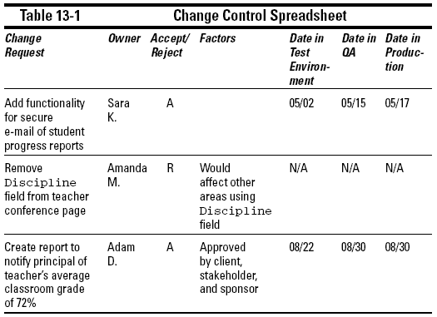
Change Control System

Slide 12
Emergency Change Requests
Although normal changes may require CCB approval during its regularly scheduled meetings, you may want to create a separate process for emergency changes.
Be sure to define what constitutes an emergency change:
For Example: In some firms, an emergency change is anything that, left alone, may cause the organization to lose money.
Make sure that stakeholders complete the appropriate documentation so that you have a record of who approved the change and why it was implemented without CCB approval.

Slide 13
Controlling Project Costs
If you allow your costs to vary from your original plan without going through the appropriate processes to
identify the need for changes,
gain the appropriate approval,
and follow the identified change control processes,
you won’t just affect the cost of your project, but you could also negatively affect other areas of the project as well.

Slide 14
Managing Cost Variances
Throughout the project, you need to be aware of variances in what you planned for your project to cost, compared to actual costs.
Factors:
Change in Resources (replaced junior programmer with senior)
Change in Schedule (didn’t complete some task on time)
Bad Decisions (failing to plan for quality)

Slide 15
Controlling Project Schedule
As part of the controlling processes, you will be monitoring your project schedule and determining if where you are now is where you said you would be when you created your schedule.
Managing time variances
Estimating impact of change on the project schedule

Slide 16
Next
Measuring Project Performance
Tracking the Project Performance

Slide 17
Q & A

